Slide 1

IVIN
Integrated Vignan INformation

Slide 2
ABSTRACT
Our project is a website IVIN(Integrated Vignan INformation) which includes students information,sem marks,bus details,online fee payment and online examination.
Students information page consists of general and personal details.
Marks page include sem marks of an individual student.
Bus details page consists of route numbers and stops,which includes time and address too.
Online fee page consists of total fees and due amount ,where you can pay your fees online.
Online examination page includes quiz and coding websites.
We used HTML,CSS,JAVA SCRIPT,PHP,MYSQL ,XAMPP SEVER,BROWSER AND VSCODE to finish our project.

Slide 3
BLOCK DIAGRAM
IVIN WEBSITE Login
HOME
INFORMATION
MARKS
BUS DETAILS
ONLINE FEEPAYMENT
ONLINE EXAMINATION
PERSONAL INFORMATION
SEMISTER MARKS
ROUTE DETAILS
COLLEGE FEE
MCQ’S
GENERAL INFORMATION
STOP DETAILS
BUS FEE
CODING

Slide 4


Home page
ENTER THE ROLL
NUMBER AND D.O.B
TO LOGIN
AFTER SUCCESFUL
LOGIN WE WILL DIRECT TO HOME PAGE

Slide 5
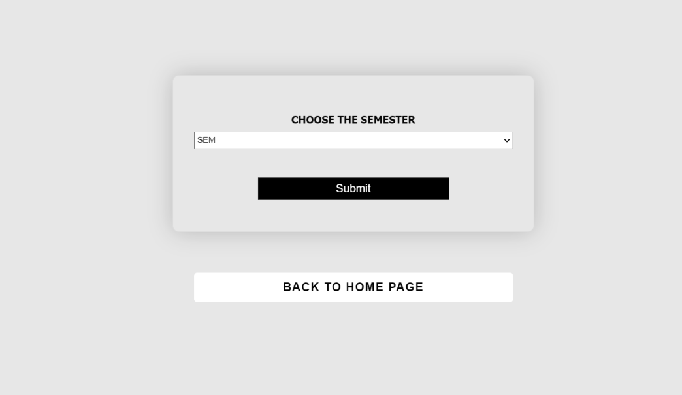
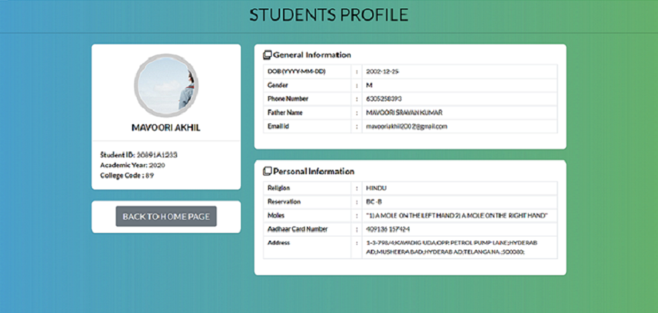
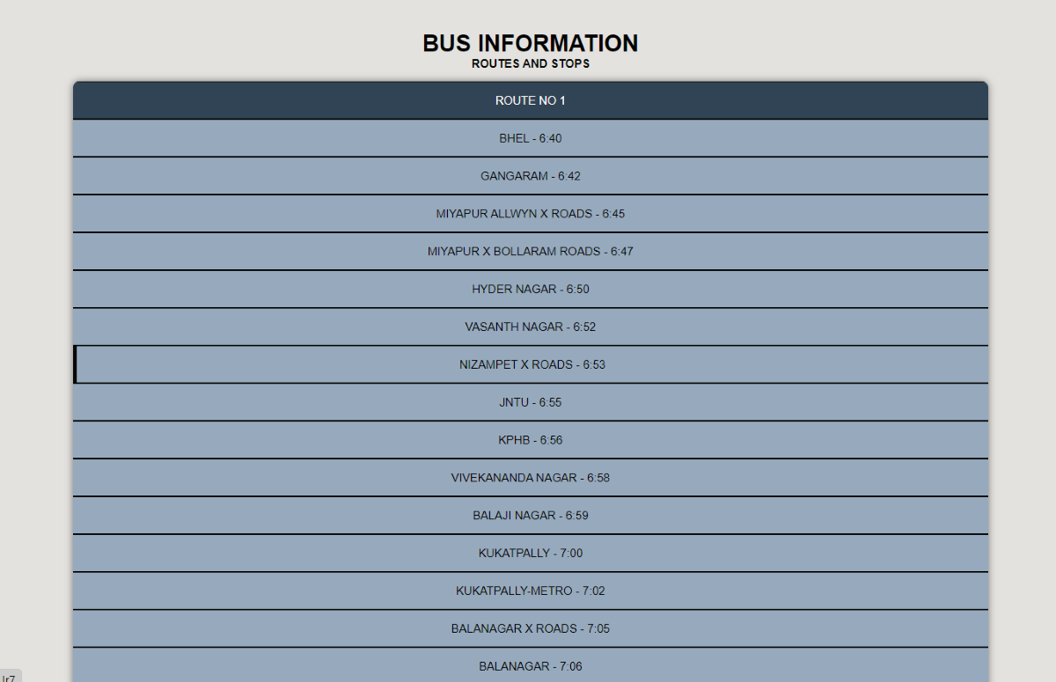

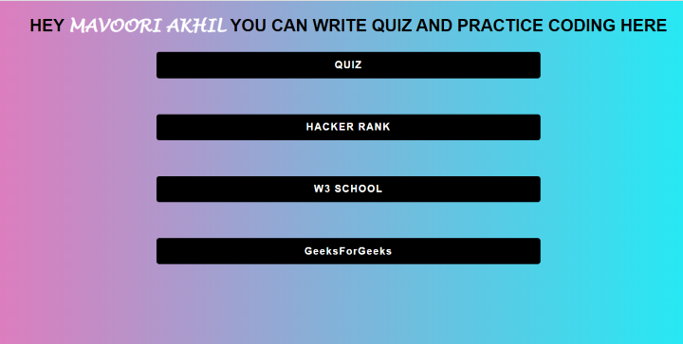
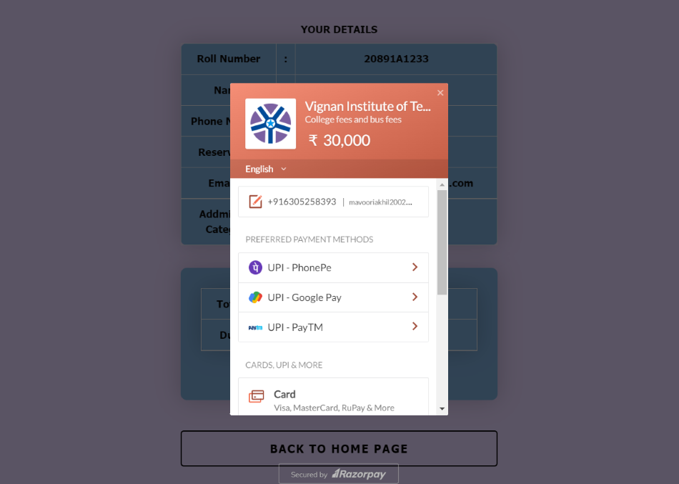
Home page

Slide 6
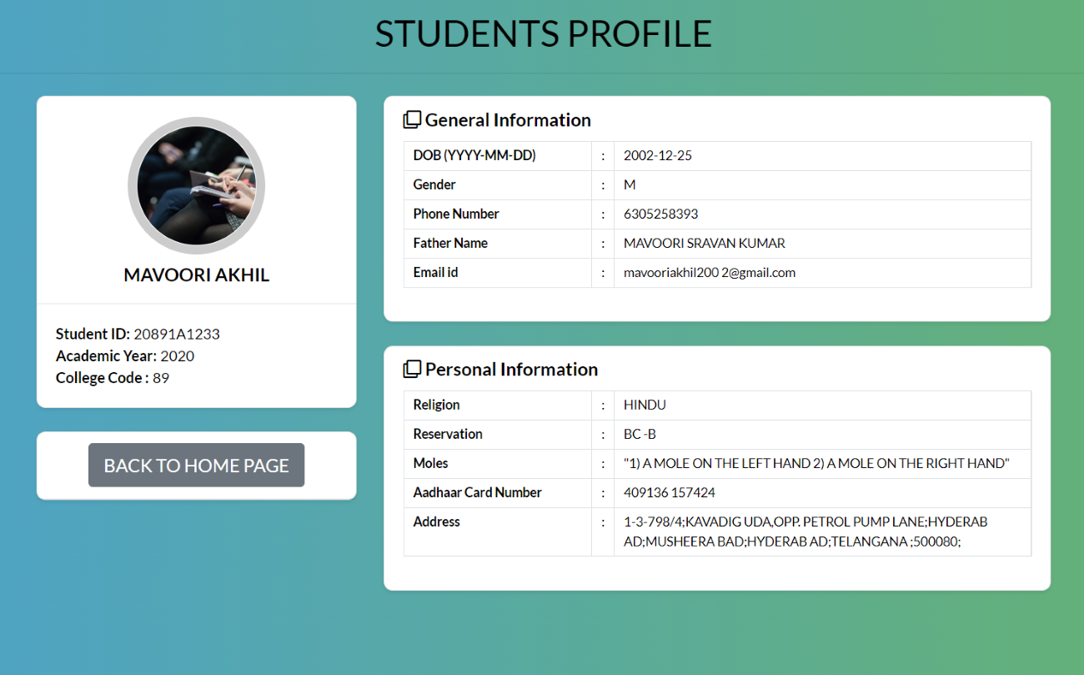
STUDENT PROFILE:
IT CONTAINS THE GENERAL INFORMATION ABOUT THE STUDENT LIKE D.O.B,GENDER,
PHO NO. ,FATHER NAME
EMAIL ID
IT CONATINS THE ID NO. ACADEMIC YEAR AND COLLEGE CODE
IT CONATINS THE PERSONAL
INFORMATION ABOUT THE
STUDENT LIKE RELIGION,
RESERVATION,AADHAR
CARD NO. ,ADDRESS

Slide 7
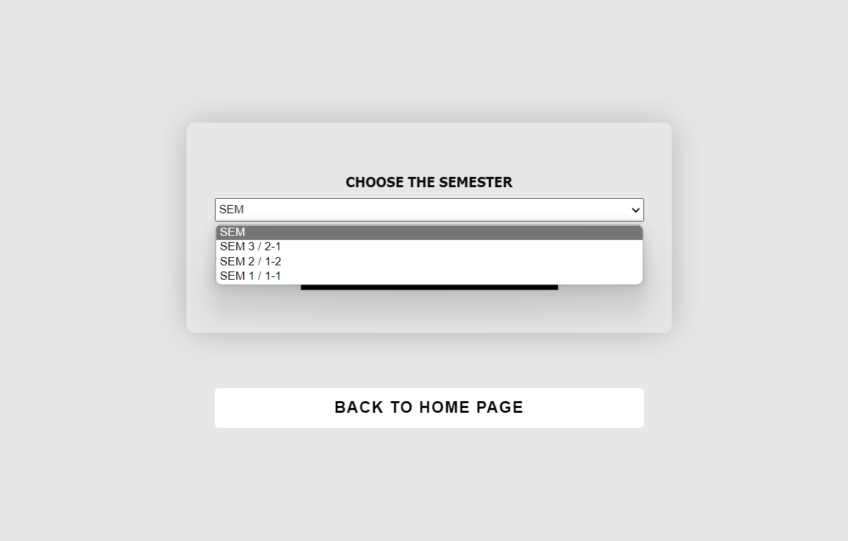
marks
HERE WE CAN GET THE ACADEMIC MARKS WE SCORED IN THE
EXAMINATION
BY SELECTING THIS WE CAN SEE THE MARKS OF SEM 2/1-2 SUBJECT MARKS
BY SELECTING THIS WE CAN SEE THE MARKS OF SEM 3/2-1 SUBJECT MARKS
BY SELECTING THIS WE CAN SEE THE MARKS OF SEM 1/1-1 SUBJECT MARKS

Slide 8
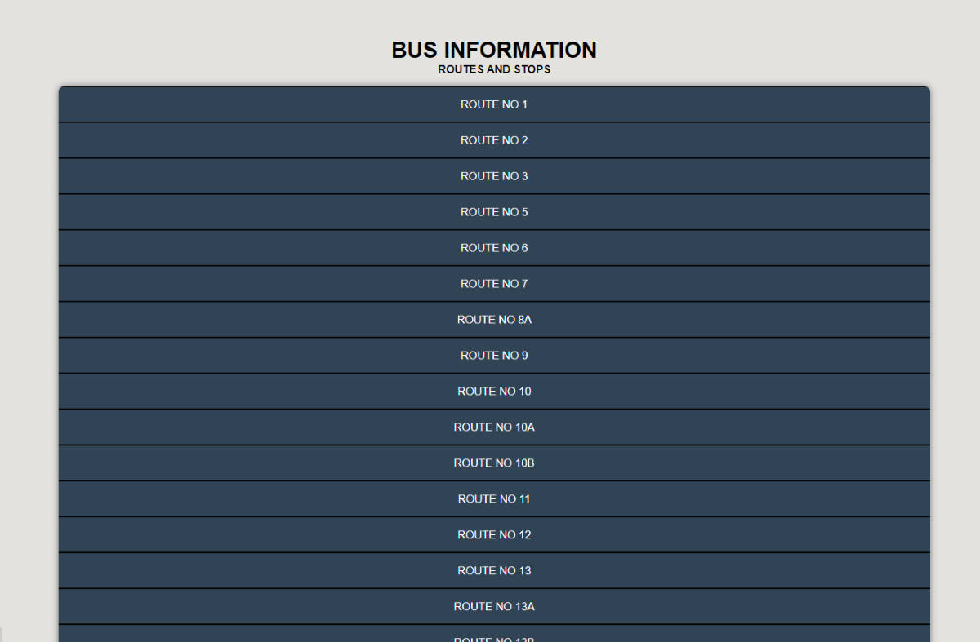
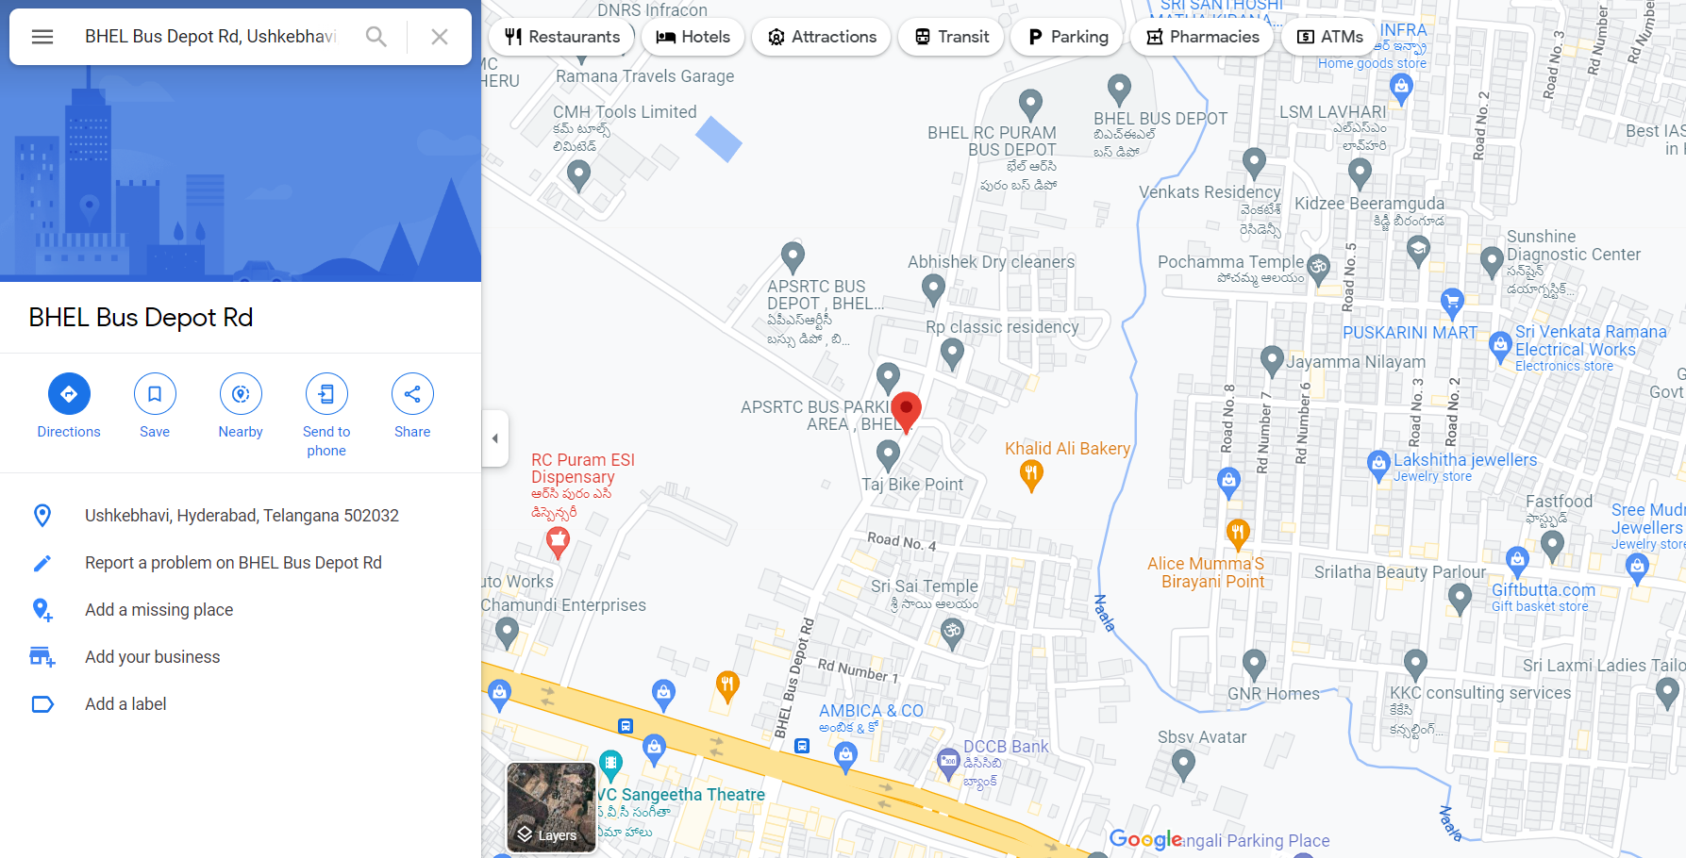
BUS ROUTES AND STOPS:
HERE IN THIS THE BUS ROUTES NO.’S WILL BE PRESENT AND WHEN WE CLICK ON THAT WE GET THE STOPS IN THAT ROUTE AND IF WE CLICK ON THE PARTICULAR STOP IT WILL DIRECT TO MAPS SO, THAT WE CAN GET THE PERFECT DIRECTIONS OT THE COLLEGE FROM THAT STOP

Slide 9
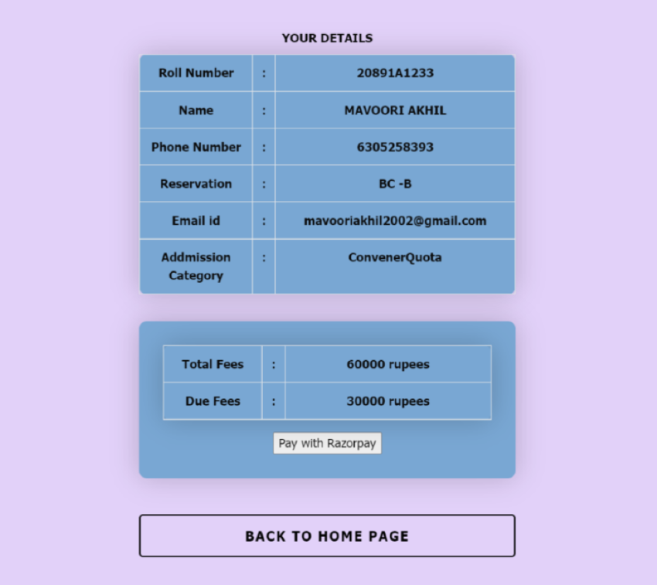
Online fee payment:
Here, we can view our entire fee structure and we can pay our college fee through razor payment

Slide 10
ONLINE EXAMINATION:
HERE SOME BASIC TECHNICAL QUESTIONS WILL BE ASKED AND YOU CAN CHECK YOUR MARKS
IT WILL DIRECT TO
W3 SCHOOL PLATFORM WHERE YOU CAN PRACTICE CODING
IT WILL DIRECT TO HACKER RANK CODING PLATFORM WHERE YOU CAN PRACTICE CODNG AND PARTICIPATE IN THE HACKERRANK CHALLENGES
IT WILL DIRECT TO GEEKS FOR GEEKS PLATFORM WHERE YOU CAN PRACTICE CODING

Slide 11
CONCLUSION
The Main Objective of Integrated Vignan Information(IVIN) is more popularly helps for our modern age system. It helps us to use the present technology into student management system . It can be helpful for quick and accurate results. Though it helps only limited sector of people , it is cost efficient, eco friendly and so on.

Slide 12
REQUIREMENTS
HTML
CSS
JAVA SCRIPT
PHP
MY SQL
XAMPP SERVER
BROWSER
VS CODE

Slide 13
BY:
MAVOORI AKHIL (20891A1233)
NAKKA SREENIDHI (20891A1235)
PARASAGANI SRINATH (20891A1240)
MADAMCHATTI SAI CHETANA (20891A1248)
GUIDE:
P SHIVA RAMA KRISHNA
DEPARTMENT OF INFORMATION
TECHNOLOGY

